Slide 1
Deep Feedforward Networks Lecture slides for Chapter 6 of Deep Learning

Slide 2
Roadmap
Example: Learning XOR
Gradient-Based Learning
Hidden Units
Architecture Design
Back-Propagation

Slide 3
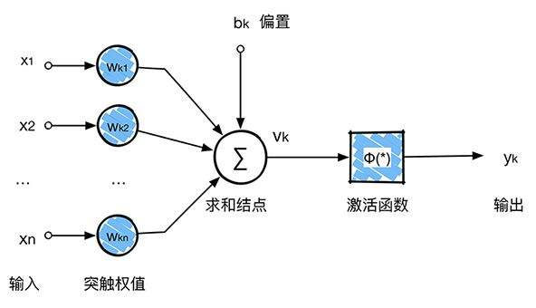
Neural Network

Slide 4
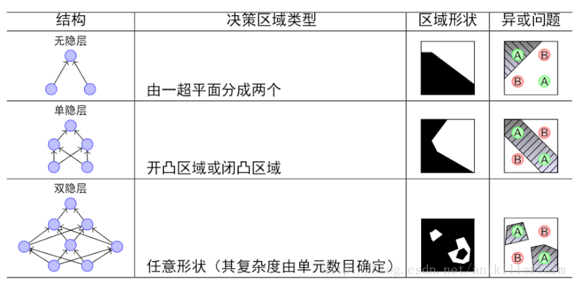
Neural Network

Slide 5
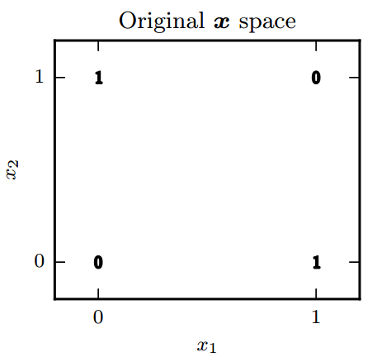
Example: Learning XOR
x1 | x2 | Y
0 | 0 | 0
1 | 0 | 1
0 | 1 | 1
1 | 1 | 0

Slide 6
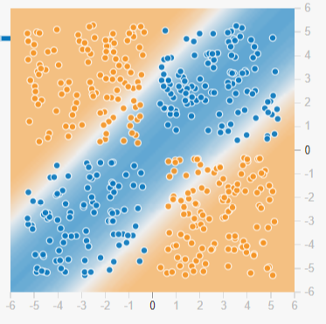
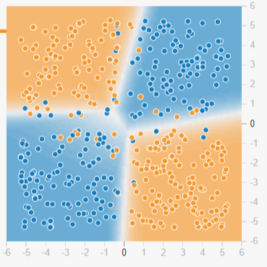
Example: Learning XOR

Slide 7
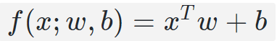
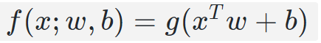
Example: Learning XOR

Slide 8
Example: Learning XOR
+0，+1.2
+0，-1.4
+0+0+1.2=+1.2
0+0+0
0-1.4+1.2=-0.2
+0，+1.2
+1.2+0+0=+1.2
+1.2-1.4+1.2=+1
+1.2-1.4+0=-0.2

Slide 9
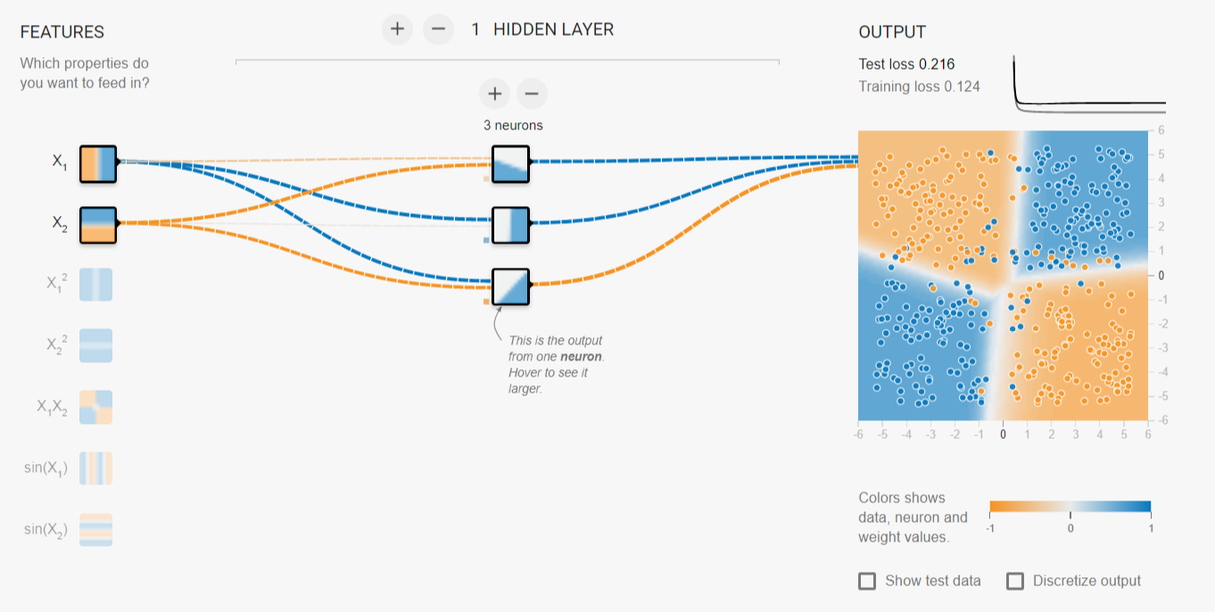
Example: Learning XOR

Slide 10
Gradient-Based Learning
An optimization procedure
A cost function
A model family

Slide 11
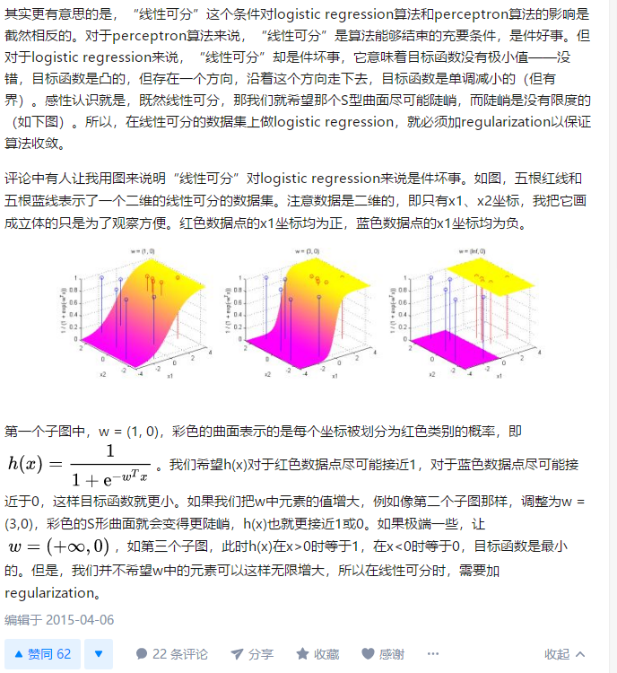
Gradient-Based Learning

Slide 12
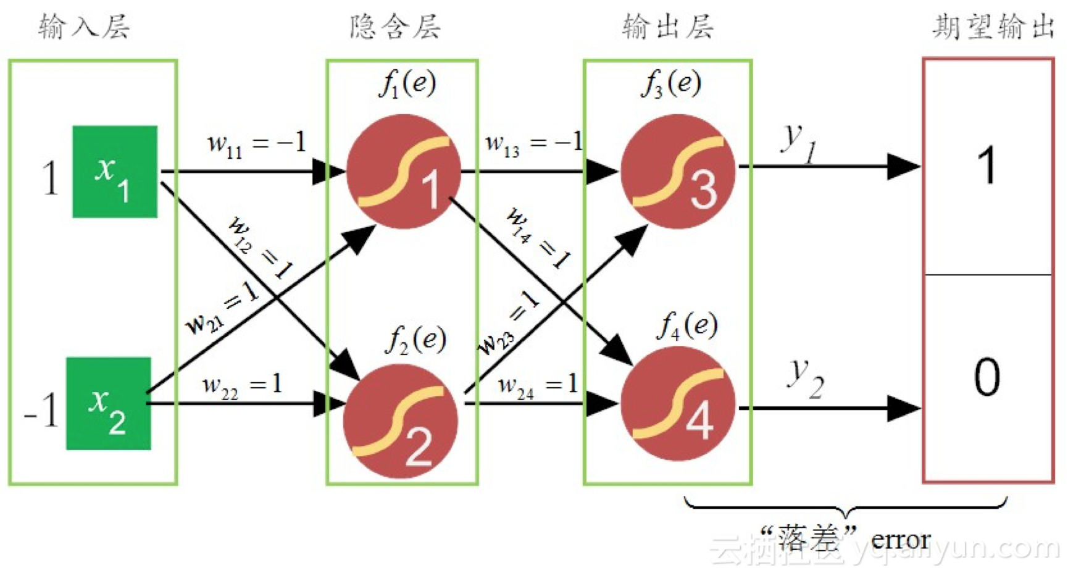
Back-Propagation

Slide 13
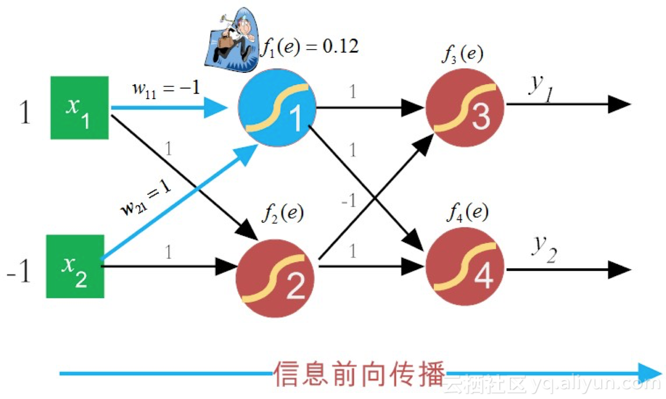
Back-Propagation

Slide 14
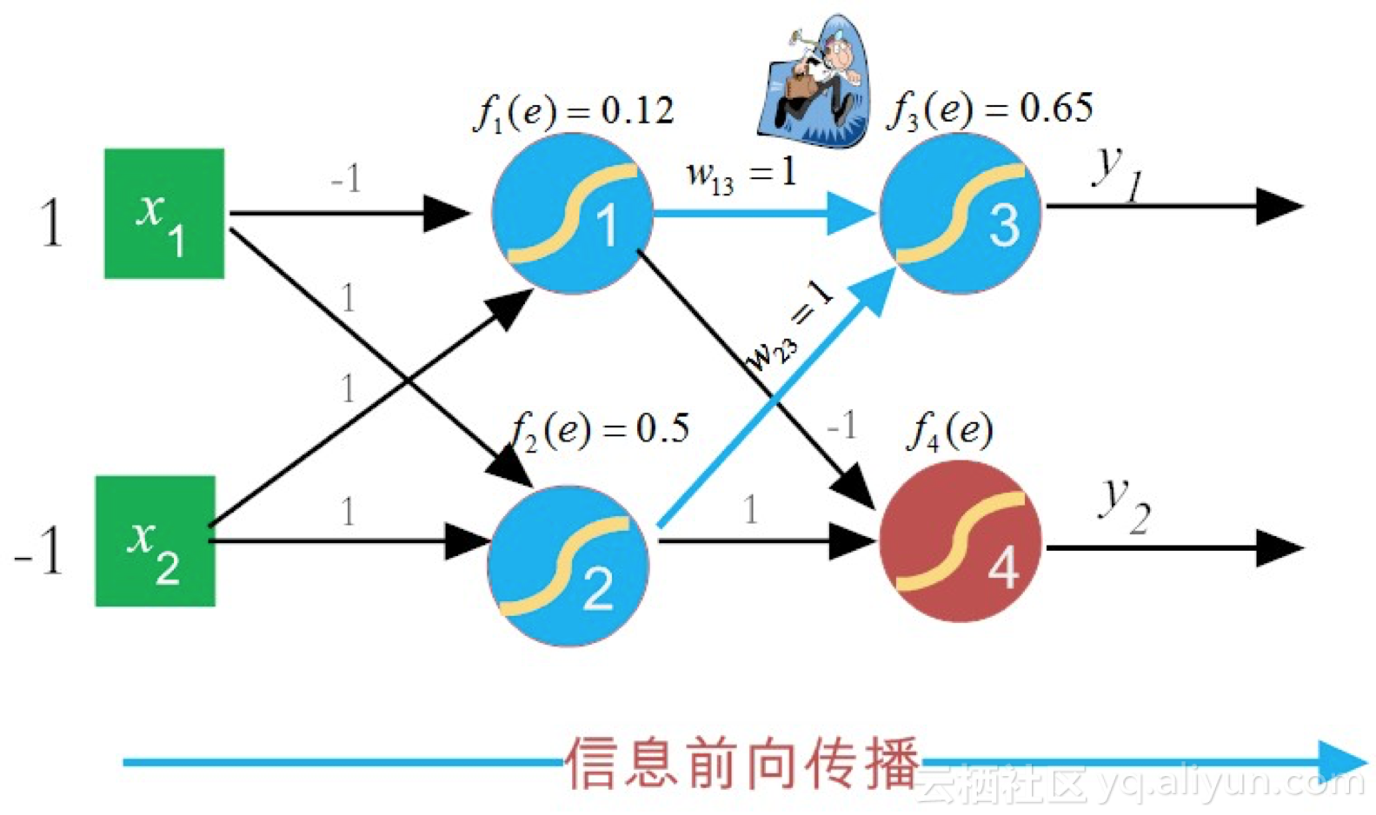
Back-Propagation

Slide 15
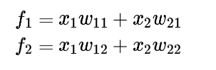
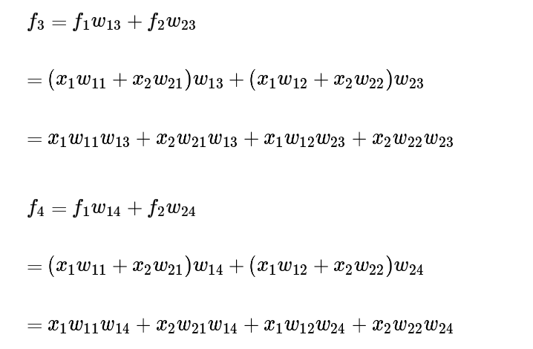
Back-Propagation

Slide 16
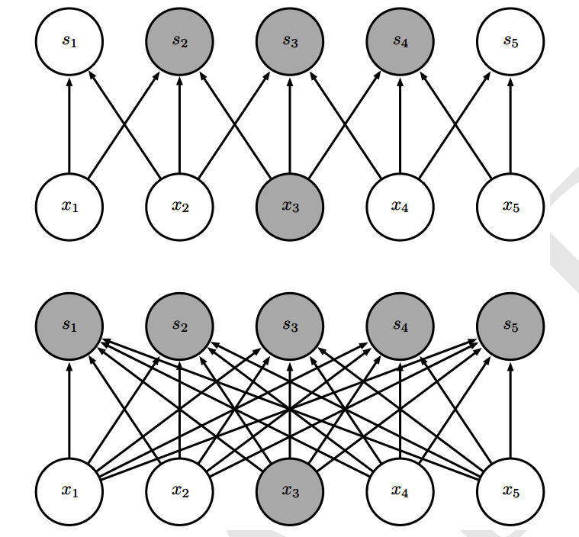
Back-Propagation

Slide 17
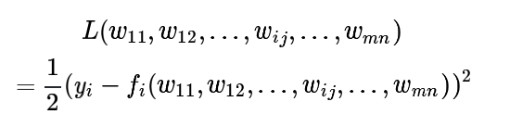
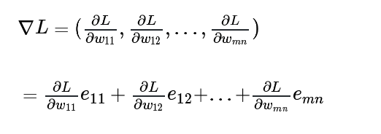
Back-Propagation

Slide 18
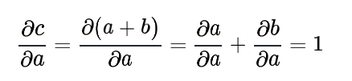
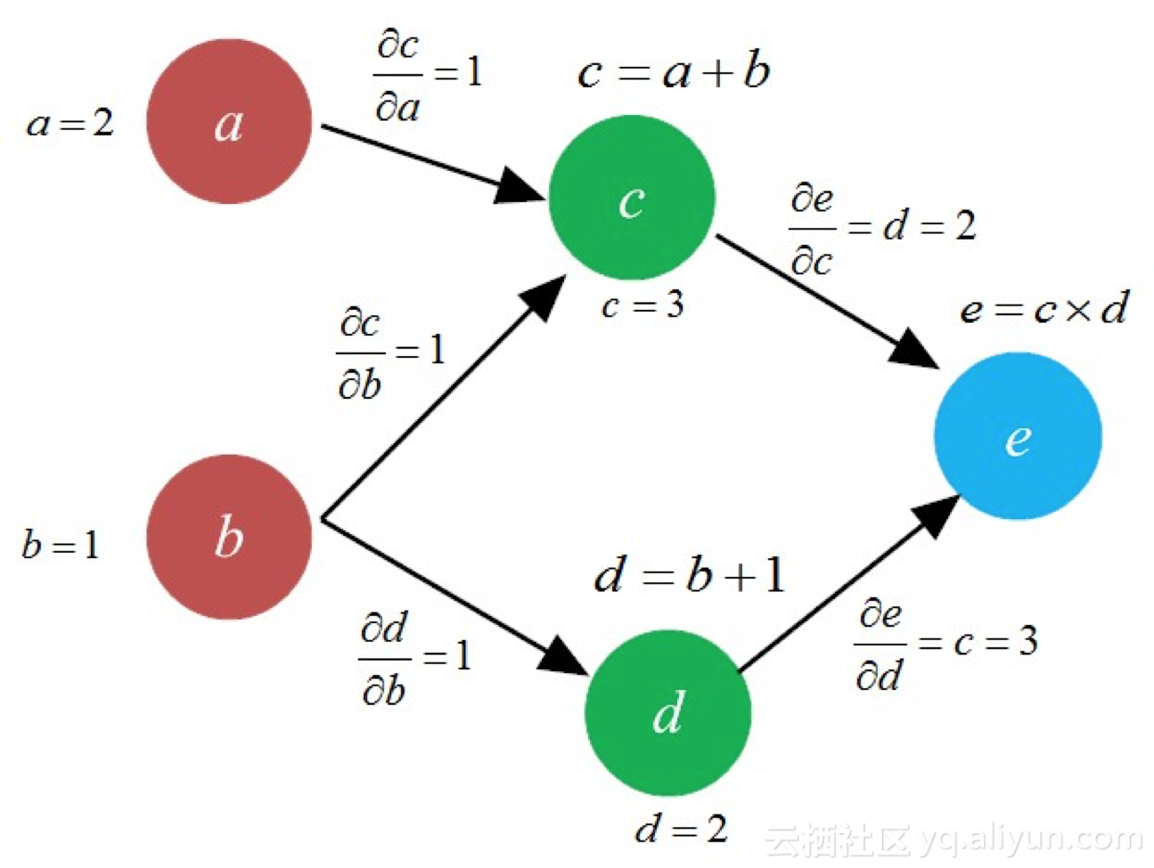
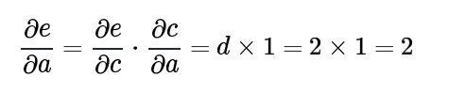
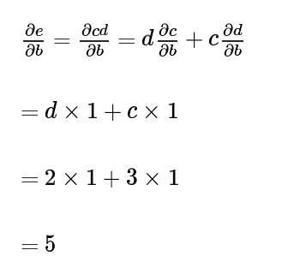
Back-Propagation

Slide 19
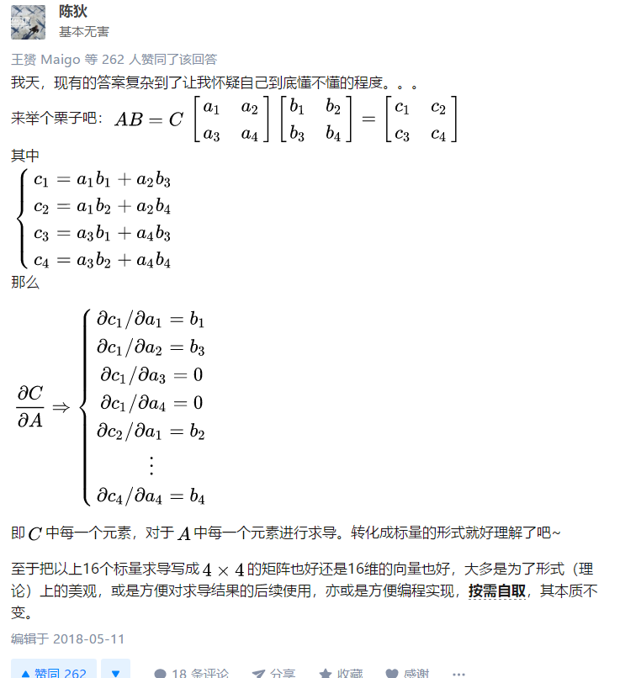
Back-Propagation

Slide 20
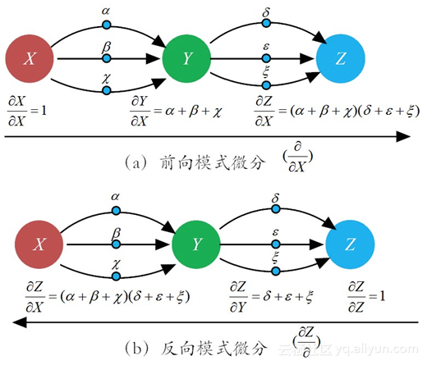
Back-Propagation

Slide 21
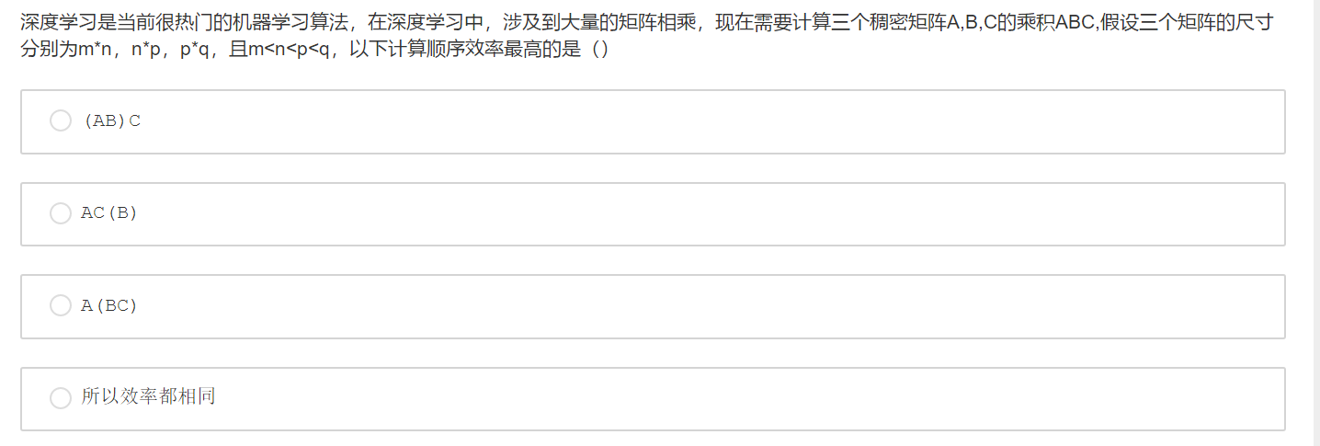
Back-Propagation

Slide 22
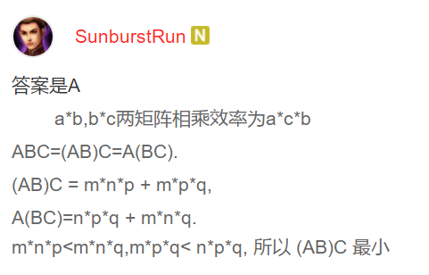
Back-Propagation

Slide 23
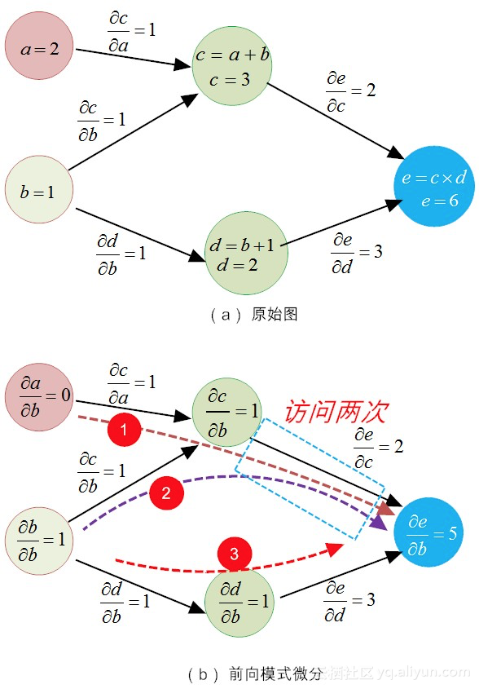
Back-Propagation

Slide 24

Understanding TensorFlow
First Key Abstraction: The Computation Graph
What is a computation graph? Essentially, it’s a global data structure: a directed graph that captures instructions about how to calculate things.
import tensorflow as tf

Slide 25
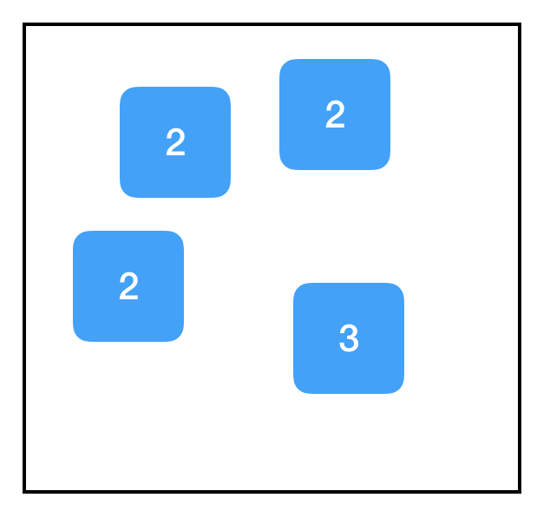
Understanding TensorFlow
First Key Abstraction: The Computation Graph
import tensorflow as tf two_node = tf.constant(2) another_two_node = tf.constant(2) two_node = tf.constant(2) tf.constant(3)

Slide 26
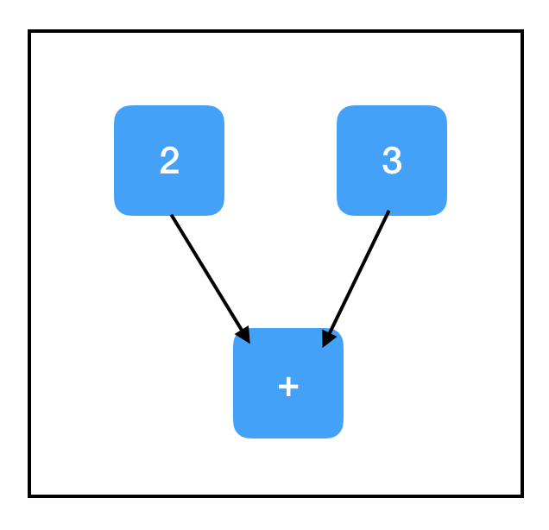
Understanding TensorFlow
First Key Abstraction: The Computation Graph
import tensorflow as tf two_node = tf.constant(2) three_node = tf.constant(3) sum_node = two_node + three_node ## equivalent to tf.add(two_node, three_node)

Slide 27
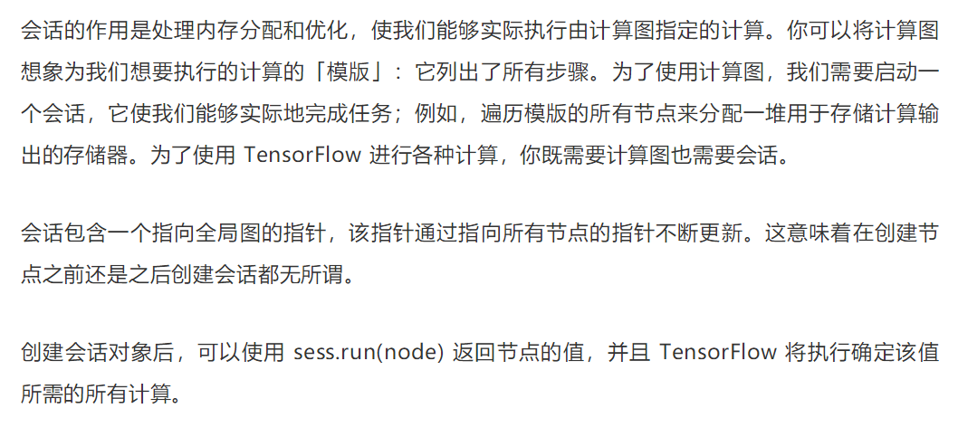
Understanding TensorFlow
Second Key Abstraction: The Session

Slide 28
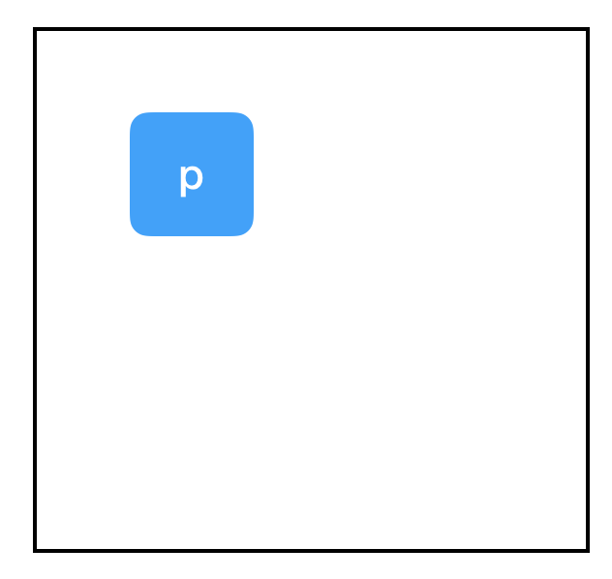
Understanding TensorFlow
placeholder
import tensorflow as tf input_placeholder = tf.placeholder(tf.int32) sess = tf.Session() print sess.run(input_placeholder, feed_dict={input_placeholder: 2})
const和placeholder都是「无祖先」节点（no-ancestor node）

Slide 29
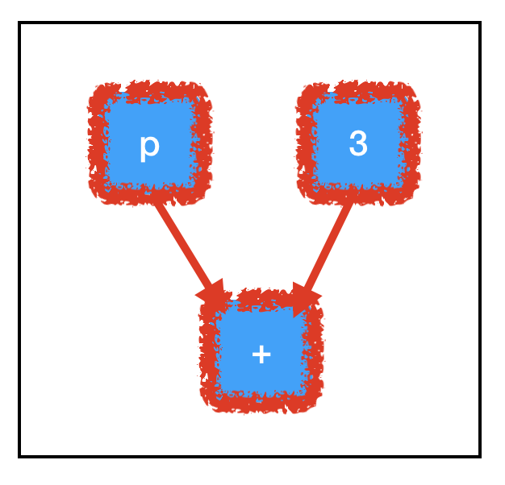
Understanding TensorFlow
Third Key Abstraction: Computation Paths
import tensorflow as tf input_placeholder = tf.placeholder(tf.int32) three_node = tf.constant(3) sum_node = input_placeholder + three_node sess = tf.Session() print sess.run(three_node) print sess.run(sum_node, feed_dict={input_placeholder: 2})

Slide 30
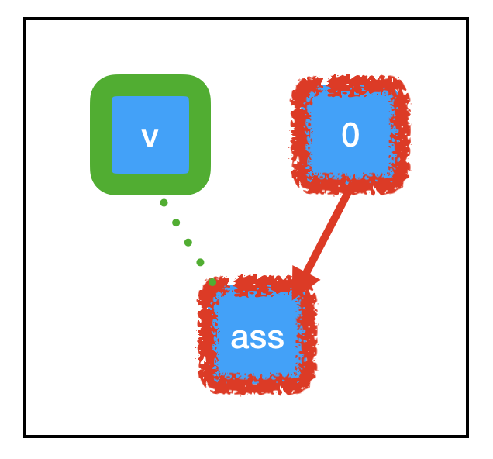
Understanding TensorFlow
Third Key Abstraction: Computation Paths
import tensorflow as tf count_variable = tf.get_variable("count", []) zero_node = tf.constant(0.) assign_node = tf.assign(count_variable, zero_node) sess = tf.Session() sess.run(assign_node) print sess.run(count_variable)

Slide 31
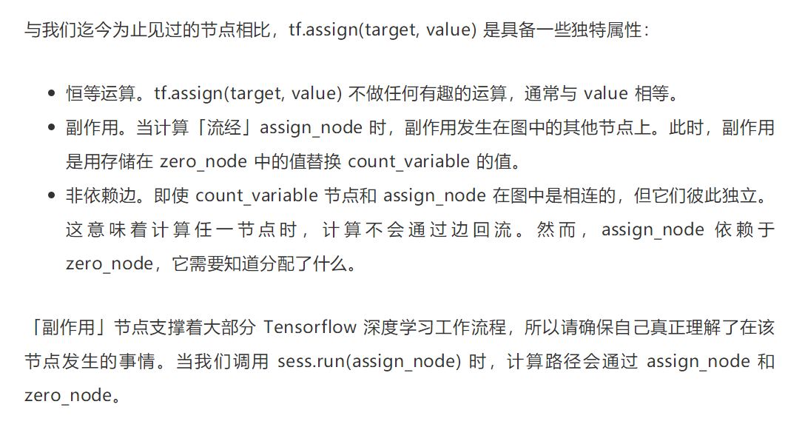
Understanding TensorFlow
Third Key Abstraction: Computation Paths
import tensorflow as tf count_variable = tf.get_variable("count", []) zero_node = tf.constant(0.) assign_node = tf.assign(count_variable, zero_node) sess = tf.Session() sess.run(assign_node) print sess.run(count_variable)

Slide 32
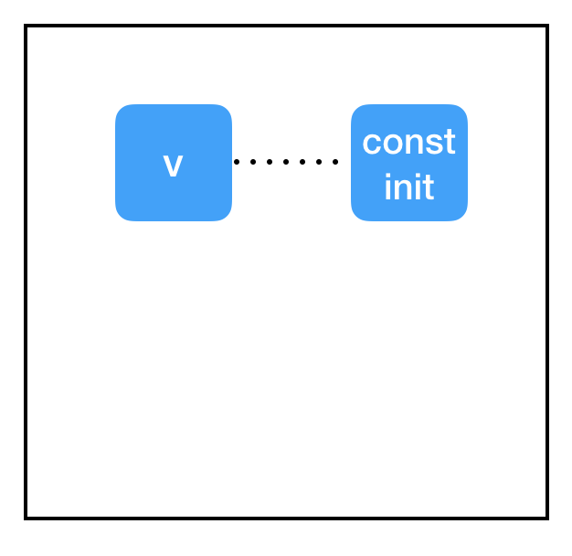
Understanding TensorFlow
Third Key Abstraction: Computation Paths
import tensorflow as tf const_init_node = tf.constant_initializer(0.) count_variable = tf.get_variable("count", [], initializer=const_init_node) sess = tf.Session() print sess.run([count_variable])

Slide 33
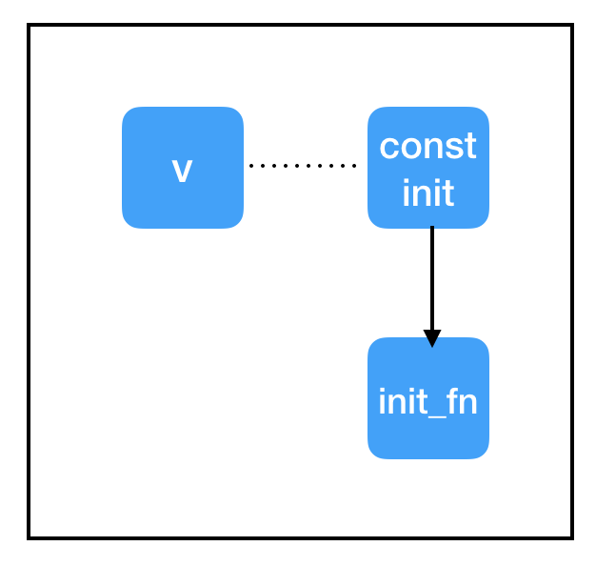
Understanding TensorFlow
Third Key Abstraction: Computation Paths
import tensorflow as tf const_init_node = tf.constant_initializer(0.) count_variable = tf.get_variable("count", [], initializer=const_init_node) init = tf.global_variables_initializer() sess = tf.Session() sess.run(init) print sess.run(count_variable)

Slide 34
Understanding TensorFlow
Third Key Abstraction: Computation Paths
import tensorflow as tf const_init_node = tf.constant_initializer(0.) count_variable = tf.get_variable("count", [], initializer=const_init_node) init = tf.global_variables_initializer() sess = tf.Session() sess.run(init) print sess.run(count_variable)

Slide 35
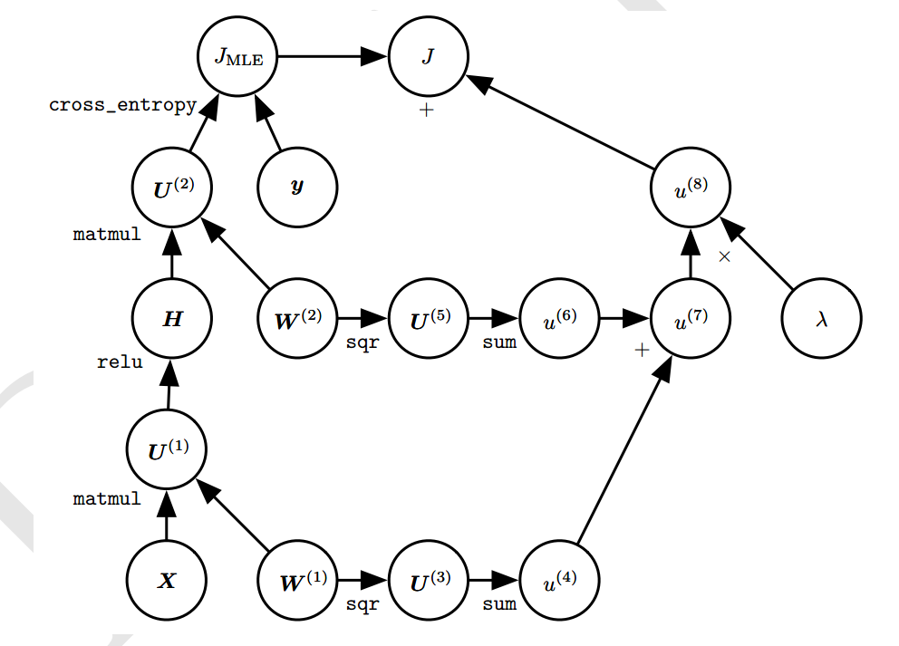
Understanding TensorFlow

Slide 36
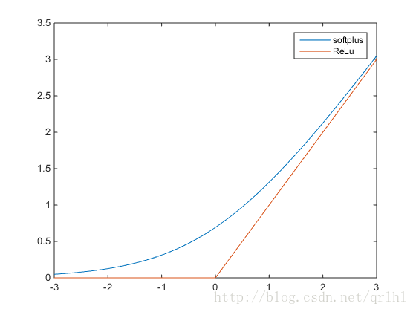
Gradient-Based Learning

Slide 37
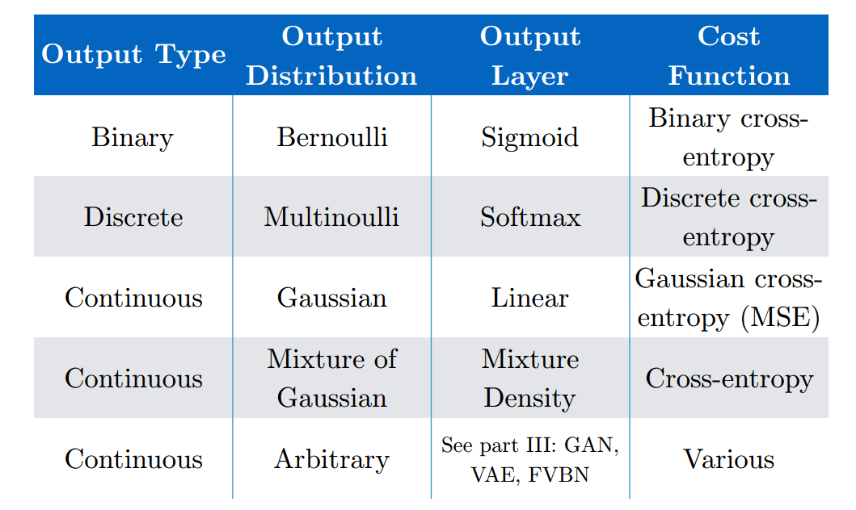
Gradient-Based Learning

Slide 38
References
《Deep Learning》
A Neural Network Playground http://playground.tensorflow.org/
线性可分的数据集下，感知机模型是否是凸优化问题？ - 王赟 Maigo的回答 - 知乎 https://www.zhihu.com/question/29163846/answer/43849528
Tensorflow: The Confusing Parts
https://jacobbuckman.com/post/tensorflow-the-confusing-parts-1/

